Slide 1
Introduction to Artificial Intelligence
Litty Tressa George
Lecturer FICT
Section 1 PPT 3

Slide 2
Machine Learning
Machine learning is an application of artificial intelligence (AI) that provides systems the ability to automatically learn and improve from experience without being explicitly programmed.
Therefore, as it trains over the examples, again and again, it is able to identify patterns in order to make predictions about the future.
Data is the core backbone of machine learning algorithms.
With the help of the historical data, we are able to create more data by training process using machine learning algorithms. For example, Generative Adversarial Networks are an advanced concept of Machine Learning that learns from the historical images through which they are capable of generating more images.

Slide 3
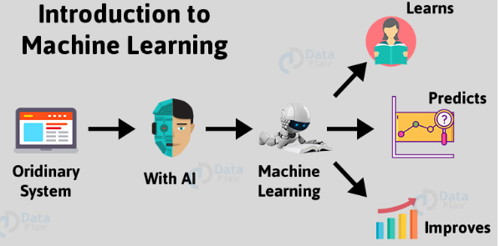

Slide 4
This is also applied towards speech and text synthesis.
Therefore, Machine Learning has opened up a vast potential for data science applications.
Machine Learning combines computer science, mathematics, and statistics. Statistics is essential for drawing inferences from the data. Mathematics is useful for developing machine learning models and finally, Computer science is used for implementing algorithms.
Note: Artificial Intelligence is the superset of Machine Learning i.e. all the Machine Learning is Artificial Intelligence but not all the AI is Machine Learning.

Slide 5
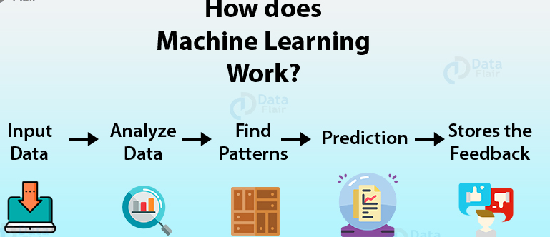

Slide 6
Machine Learning example
– Google is able to provide you with appropriate search results based on browsing habits.
– Similarly, Netflix is capable of recommending the films or shows that you would want to watch based on the machine learning algorithms that perform predictions based on your watch history.

Slide 7
Machine Learning - Terminologies
Model
A model is a specific representation learned from data by applying some machine learning algorithm. A model is also called hypothesis.
Feature
A feature is an individual measurable property of our data. A set of numeric features can be conveniently described by a feature vector. Feature vectors are fed as input to the model. For example, in order to predict a fruit, there may be features like color, smell, taste, etc. Note: Choosing informative, discriminating and independent features is a crucial step for effective algorithms. We generally employ a feature extractor to extract the relevant features from the raw data.

Slide 8
Target (Label) A target variable or label is the value to be predicted by our model. For the fruit example discussed in the features section, the label with each set of input would be the name of the fruit like apple, orange, banana, etc.
Training
The idea is to give a set of inputs(features) and it’s expected outputs(labels), ie the learning process which find out all the existing relations in the supplied data. So after training, we will have a model (hypothesis) that will then map new data to one of the categories trained on.
Prediction
Once our model is ready, it can be fed a set of inputs to which it will provide a predicted output(label).

Slide 9
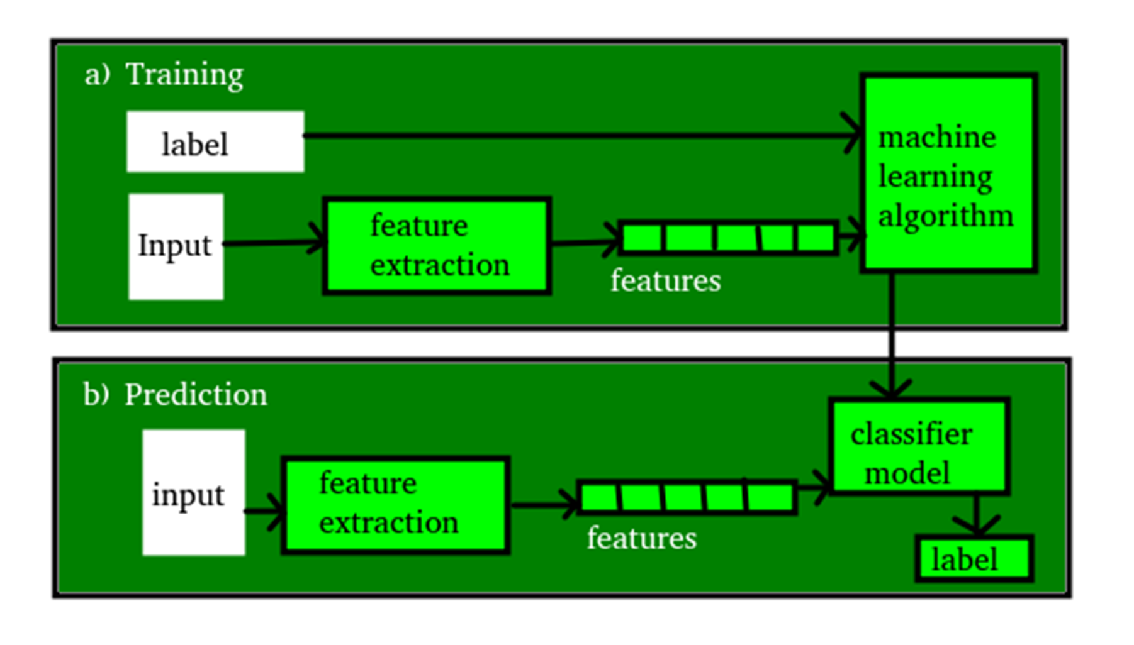
Slide Title

Slide 10
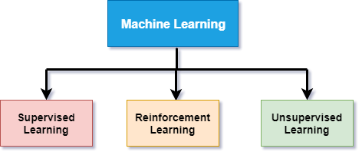
Machine Learning Types

Slide 11
Machine Learning Categories- On Basis Of The Nature Of
Learning Methodology
Supervised Learning
The computer is presented with example inputs and their desired outputs, given by a “teacher”, and the goal is to learn a general rule that maps inputs to outputs.
The training process continues until the model achieves the desired level of accuracy on the training data.
Some real-life examples are:
Image Classification: You train with images/labels. Then in the future you give a new image expecting that the computer will recognize the new object.
Market Prediction/Regression: You train the computer with historical market data and ask the computer to predict the new price in the future.

Slide 12
Semi-Supervised Learning
Problems where you have a large amount of input data and only some of the data is labeled, are called semi-supervised learning problems.
These problems lies in between both supervised and unsupervised learning.
For example, a photo archive where only some of the images are labeled, (e.g. dog, cat, person) and the majority are unlabeled

Slide 13
Unsupervised Learning
No labels are given to the learning algorithm, leaving it on its own to find structure in its input.
The training dataset is a collection of examples without a specific desired outcome or correct answer.
The system has to understand itself from the data set we provide and then generate some rule to classify
It is used for clustering population in different groups.
Unsupervised learning can be a goal in itself (discovering hidden patterns in data).
Unsupervised learning algorithms can be classified into two categories of algorithms:
Clustering
Association
Clustering: You ask the computer to separate similar data into clusters, this is essential in research and science.
Association: Task will be find the interesting relations between variables in large databases.

Slide 14
Reinforcement Learning
A computer program interacts with a dynamic environment in which it must perform a certain goal (such as driving a vehicle or playing a game against an opponent).
The program is provided feedback in terms of rewards and punishments as it navigates its problem space.
Reinforcement learning is a type of learning in which an AI agent is trained by giving some commands, and on each action, an agent gets a reward as a feedback.
Using these feedbacks, agent improves its performance.
Eg:-Video games
Once Completed a level , then — earn a badge. Defeat the bad guy in a certain number of moves and — earn a bonus. Step into a trap — game over.
The feed back help players learn how to improve their performance for the next game

Slide 15
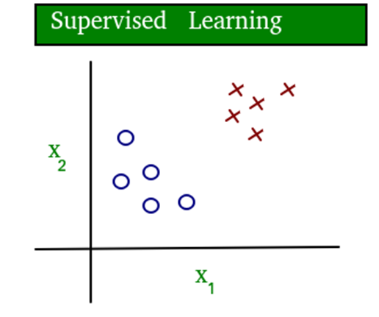
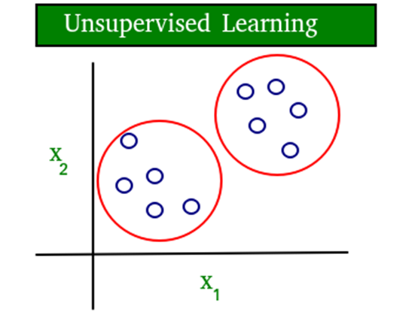
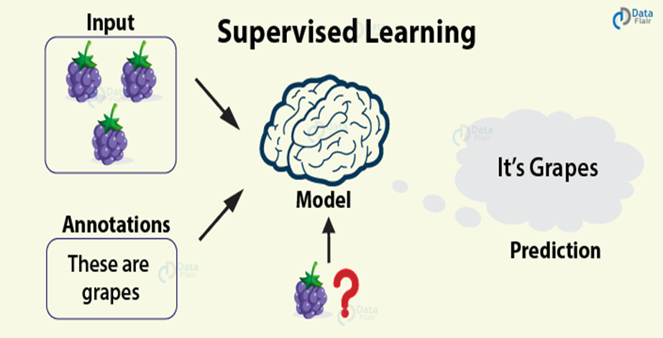
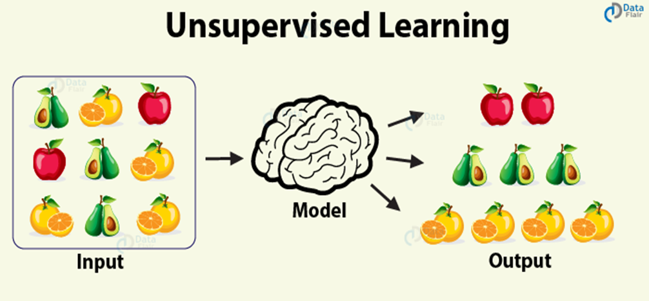

Slide 16
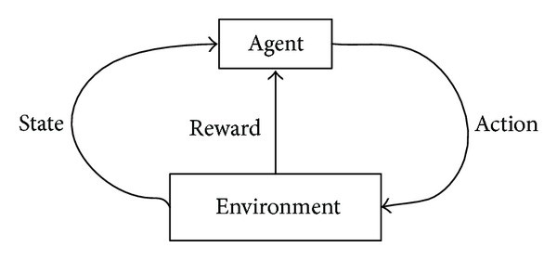
Reinforcement Learning

Slide 17
The Seven Steps Of Machine Learning
Gathering Data:
Once you know exactly what you want and the equipments are in hand, it takes you to the first real step of machine learning- Gathering Data.
This step is very crucial as the quality and quantity of data gathered will directly determine how good the predictive model will turn out to be.
The data collected is then tabulated and called as Training Data.
2. Data Preparation:
After the training data is gathered, you move on to the next step of machine learning ie Data preparation, where the data is loaded into a suitable platform and then prepared for use in machine learning training.
Here, the data is first put all together and then the order is randomized as the order of data should not affect what is learned.

Slide 18
This is also a good enough time to do any visualizations of the data, as that will help you see if there are any relevant relationships between the different variables, how you can take their advantage and as well as show you if there are any data imbalances present.
The other forms of adjusting and manipulation like normalization, error correction, and more take place at this step.

Slide 19
3. Choosing a model:
The next step that follows in the workflow is choosing a model among the many that researchers and data scientists have created over the years.
Make the choice of the right one that should get the job done.
4. Training:
After the above steps are completed, you then move onto training where the data is used to incrementally improve the model’s ability to predict.
The training process involves initializing some random values for say A and B of our model, predict the output with those values, then compare it with the model's prediction and then adjust the values so that they match the predictions that were made previously.
This process then repeats and each cycle of updating is called one training step

Slide 20
5. Evaluation:
Once training is complete, you now check if it is good enough using this step.
Evaluation allows the testing of the model against data that has never been seen and used for training and is meant to be representative of how the model might perform when in the real world.

Slide 21
6. Parameter Tuning:
Once the evaluation is over, any further improvement in your training can be possible by tuning the parameters.
Here your goal, is usually to set those parameters to so optimal values that enable you to complete a learning task in the best way possible.
Thus, it is the process which optimize the parameters that impact the model in order to enable the algorithm to perform the best .

Slide 22
Since there are many considerations at this phase of training, it’s important that you define what makes a model good.
These parameters are referred to as Hyper parameters.
A Hyper parameter is a parameter whose value is set before the learning process begins
The adjustment or tuning of these parameters depends on the dataset, model, and the training process.
Once you are done with these parameters and are satisfied you can move on to the last step.
Some examples of model hyper parameters include:
The penalty in Logistic Regression Classifier i.e. L1 or L2 regularization
The learning rate for training a neural network.
The C hyper parameters for support vector machines. (Control parameter -how much you want to avoid misclassifying each training example)
The k in k-nearest neighbors. (-K actually is the number of neighbors considered)

Slide 23
7. Prediction:
Machine learning is basically using data to answer questions.
So this is the final step where you get to answer few questions.
This is the point where the value of machine learning is realized.
Here you can Finally use your model to predict the outcome of what you want.
The above-mentioned steps take you from where you create a model to where you Predict its output and thus acts as a learning path.

Slide 24
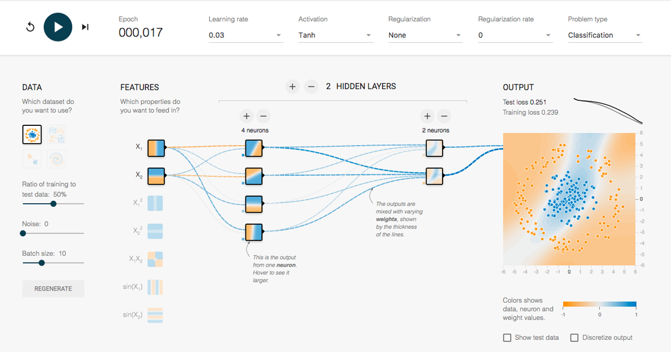
Tensor Flow Playground
For more ways to play with training and parameters, check out the Tensor Flow Playground.
It’s a completely browser-based machine learning sandbox where you can try different parameters and run training against mock datasets

Slide 25
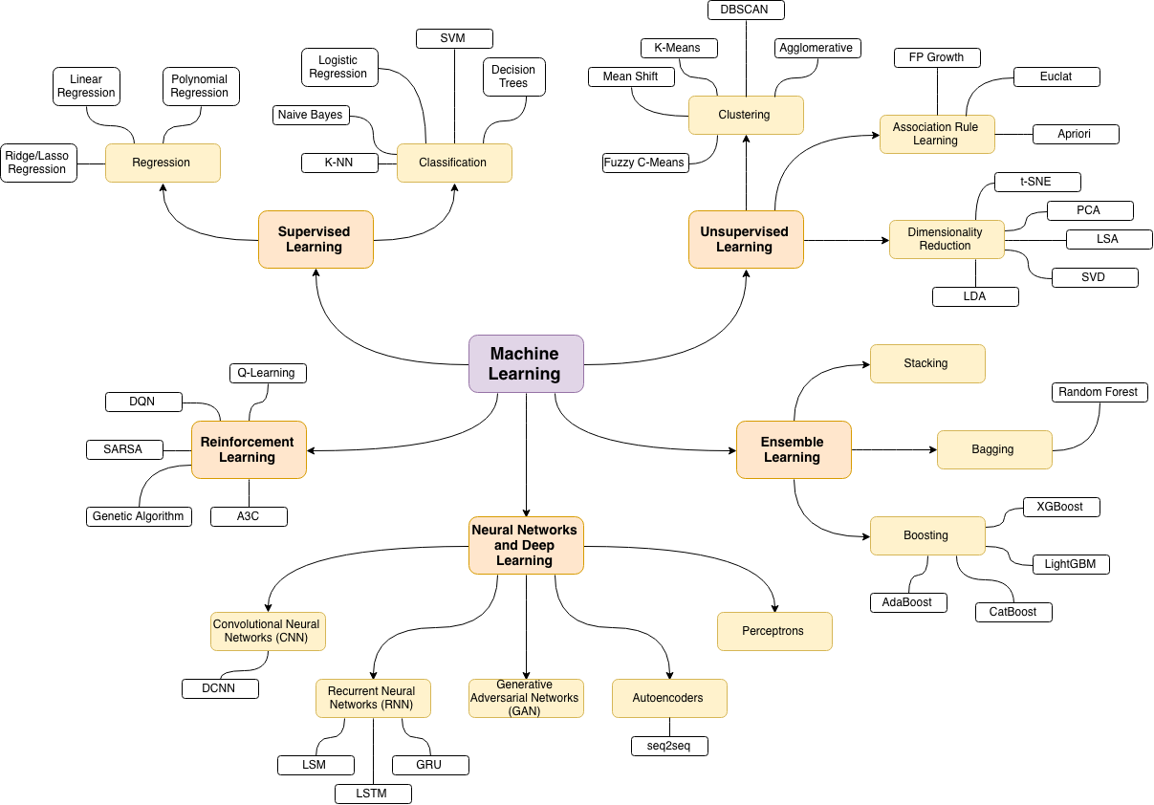

Slide 26
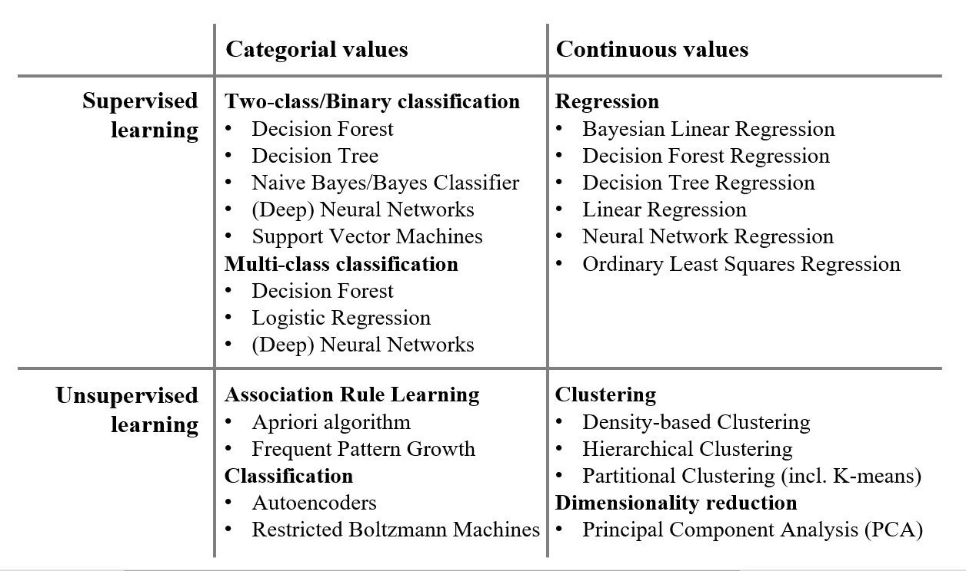
Supervised & Unsupervised Algorithms - Categorization

Slide 27
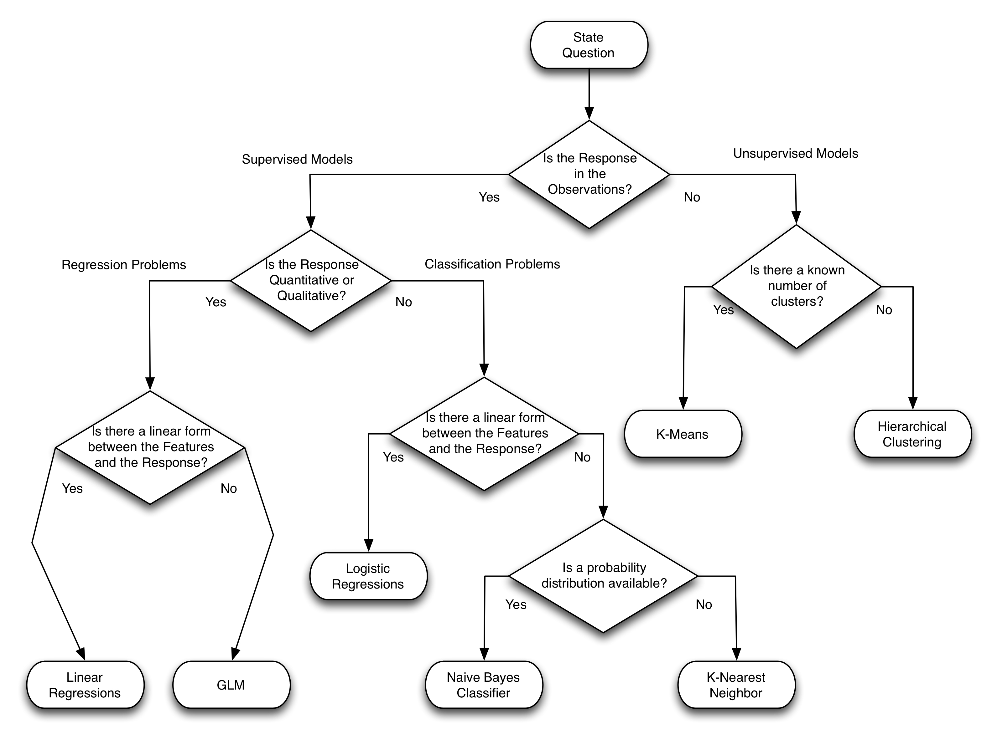
Categorization of various algorithms on the basis of the features of training data

Slide 28
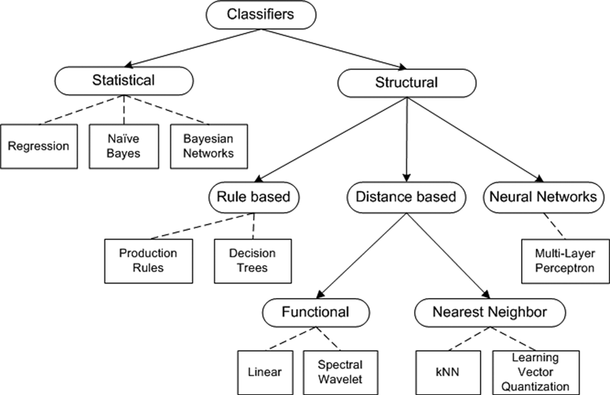

Slide 29
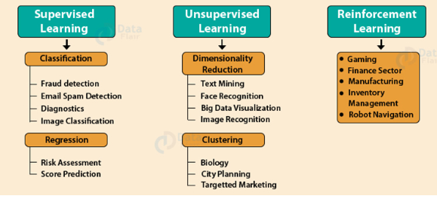
Important Use Cases Of Machine Learning Paradigms

Slide 30

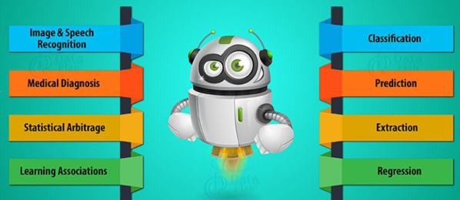

Slide 31
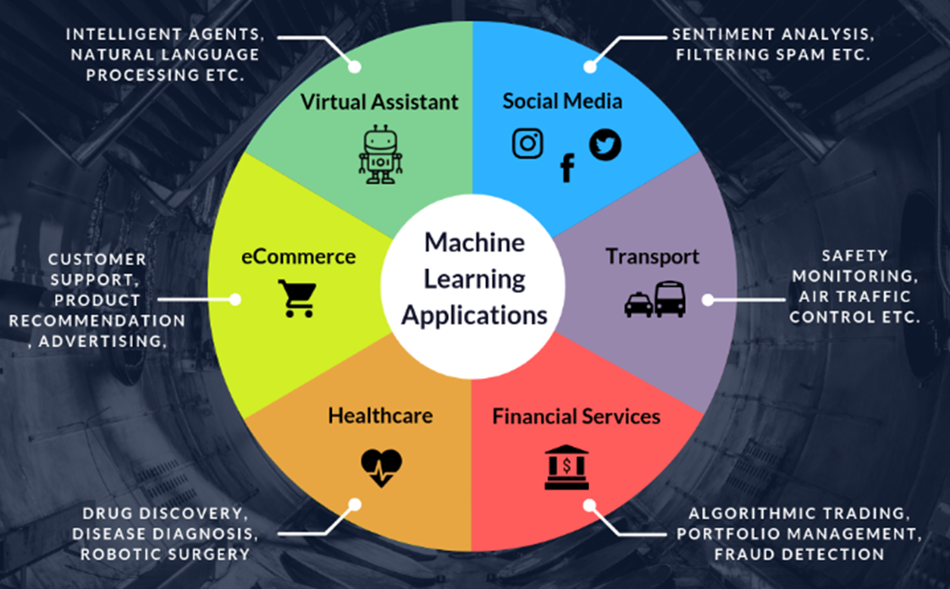

Slide 32
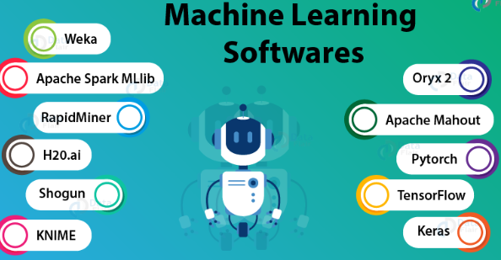
These are several softwares that will allow you to implement machine learning algorithms with ease.
These are the softwares and tools that facilitate both rapid prototyping as well as an added functionality to other languages in the form of tools.
While there are umpteen software services available for developing machine learning solutions, these are the ones that have been making their name in this industry.

Slide 33
Activity
Write a detailed note on the following
Various machine learning tools and softwares .
Various machine learning applications.

